Slide 1
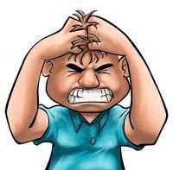
Me
Telemarketing Drone

Slide 2
 | Motorist Cooperates | Motorist Betrays
All Other Motorists Cooperate | 10 minute commute | 5 minute commute
All Other Motorists Betray | 30 minute commute | 2 hour commute

